Slide 1
Predicting Opioid Prescription Rate By County
Daniel Lee

Slide 2
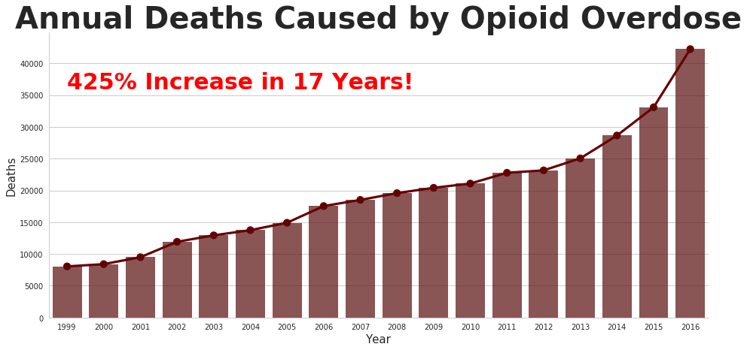

Slide 3
From 1999 to 2016 in America, the increase in deaths due to opioid overdose increased by 425%, from 8,050 deaths in 1999 to 42,249 deaths in 2016. That's over four times the increase in 17 years.

Slide 4
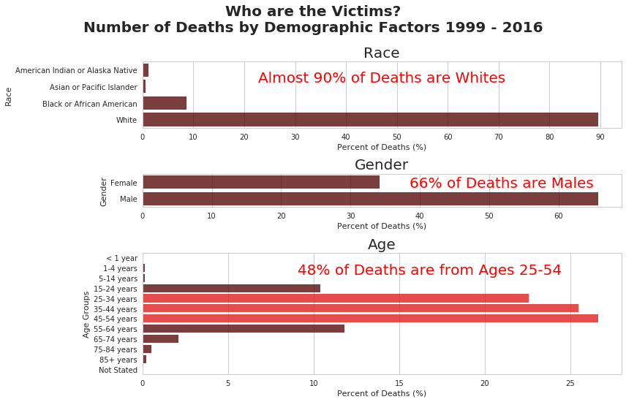

Slide 5

Living With An Opioid Addiction

Slide 6
Why We Should Care
Not represented in the death numbers are those who are struggling with opioid addiction
Addiction to opioids, like any other addictions, leads to
Financial problems
Health problems
Lack of self control
Relational difficulties
Destruction of every aspect of the person
End result is death
Dangers recognized by other nations
E.g. in the 1950s China
Banned opium
Executed those who were caught selling opium

Slide 7
What is the opioid epidemic?
Wikipedia defines the opioid epidemic as the following:
Rapid increase in the use of prescription and non-prescription opioid drugs in the United States and Canada beginning in the late 1990s and continuing throughout the next two decades.
Opioids
Diverse class of moderately strong painkillers
Oxycodone (commonly sold under the trade names OxyContin and Percocet)
Hydrocodone (Vicodin)
Fentanyl
Synthesized to resemble other opiates such as opium-derived morphine and heroin
Source: https://en.wikipedia.org/wiki/Opioid_epidemic

Slide 8
Problem
Predict the county’s mortality rate caused by drug overdose for 2016 given various independent variables, such as drug overdose for 2016 given a county’s median household income, population estimates, unemployment, poverty rate estimates, educational attainment, and opioid prescription rate.

Slide 9
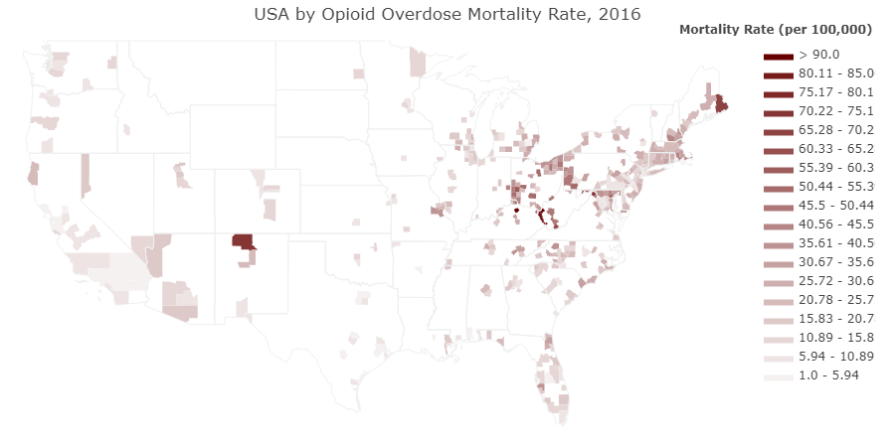

Slide 10
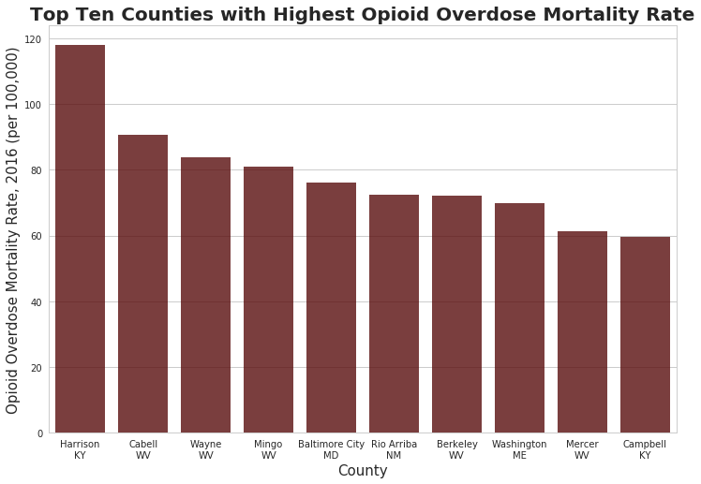

Slide 11
Counties with High Mortality Rate Due to Opioid Addiction
Highest county: Harrison, KY
118 deaths per 100,000 people due to opioid overdose
0.118% of all the people in county dying because of opioid overdose
West Virginia
Five counties in the top ten highest mortality rate

Slide 12
Description of Data
US County Opioid Prescribing Rates 2016
https://www.cdc.gov/drugoverdose/maps/rxcounty2016.html
Unemployment, median household income, educational attainment, poverty rate estimates,and population estimates:
https://www.ers.usda.gov/data-products/county-level-data-sets/download-data/
Underlying Cause of Death
https://raw.githubusercontent.com/danielhanbitlee/Springboard/master/capstone_project/drug_overdose_death_opioid_2016.txt
https://wonder.cdc.gov/controller/saved/D77/D39F042
Note that statistics representing zero to nine deaths are suppressed at the region, state and county level.

Slide 13
Variables
%_high_school_diploma_only_2012-2016 - Estimated percent of people with high school diploma only (%)
%_povall_2016 - Estimated percent of people of all ages in poverty 2016 (%)
county - County's name
county_state - County's name and state the county is located in

Slide 14
Variables
crude_opioid_mortality_rate - Estimated rate for deaths caused by opioid overdose in the county for 2016 (per 100,000 people)
Specifically, the types of drug-related deaths include the following:
Drug poisonings (overdose)
Unintentional
Suicide
Homicide
Undetermined

Slide 15
Variables
crude_opioid_mortality_rate
The specific drugs included in the death rates are the following:
Opium
Heroin
Other opioids
Methadone
Other synthetic narcotics
Other and unspecified narcotics

Slide 16
Variables
fips_code - County's unique code
fips_padded_zeros - County's unique code padded with zeros in front
gq_estimates_2016 - 7/1/2016 Group Quarters total population estimate (number of people)
all people not living in housing units (house, apartment, mobile home, rented rooms)
e.g. people living in correctional facilities
median_household_income_2016 - Estimate of median household Income, 2016 (in dollars)
opioid_prescription_rate - Prescription rate for opioids for the county (per 100 people)
pop_chg_2016 - Net change in resident total population 7/1/2015 to 7/1/2016 (number of people)

Slide 17
Variables
pop_estimate_2016 - Estimated population for the county in 2016
rate_birth_2016 - Birth rate in period 7/1/2015 to 6/30/2016 (per 1000 people)
rate_death_2016 - Overall death rate (all causes, not only caused by opioid overdose) in period 7/1/2015 to 6/30/2016 (per 1000 people)
rate_domestic_mig_2016 - Net domestic migration rate in period 7/1/2015 to 6/30/2016 (per 1000 people)
rate_international_mig_2016 - Net international migration rate in period 7/1/2015 to 6/30/2016 (per 1000 people)
state - State the county is in
unemployment_rate_2016 - Unemployment rate, 2016 (%)

Slide 18
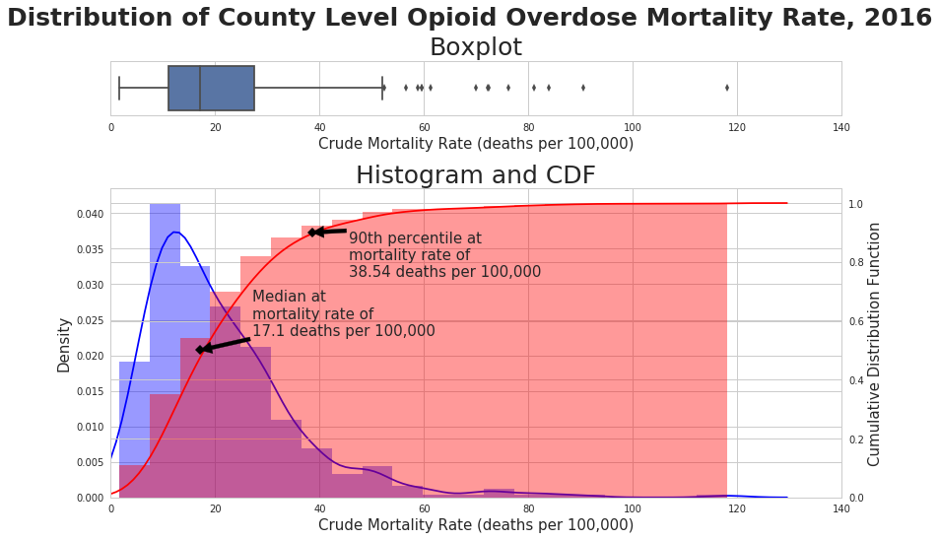

Slide 19
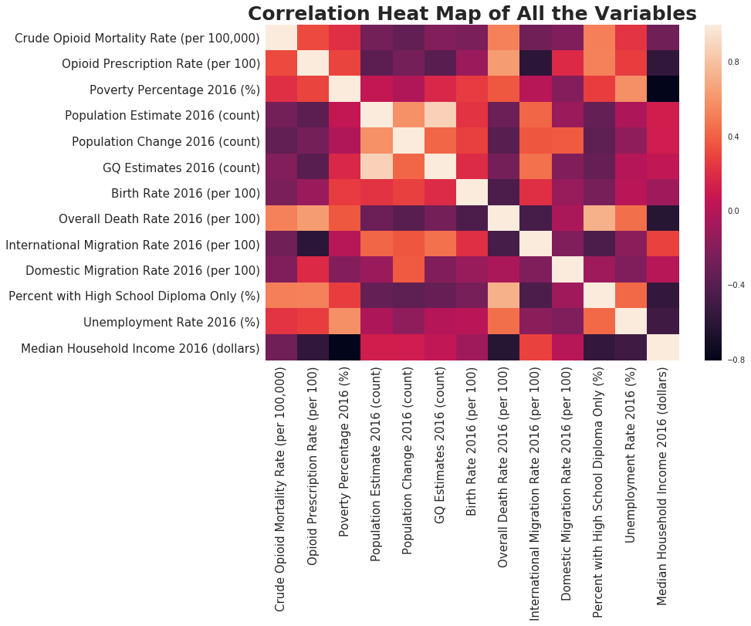

Slide 20
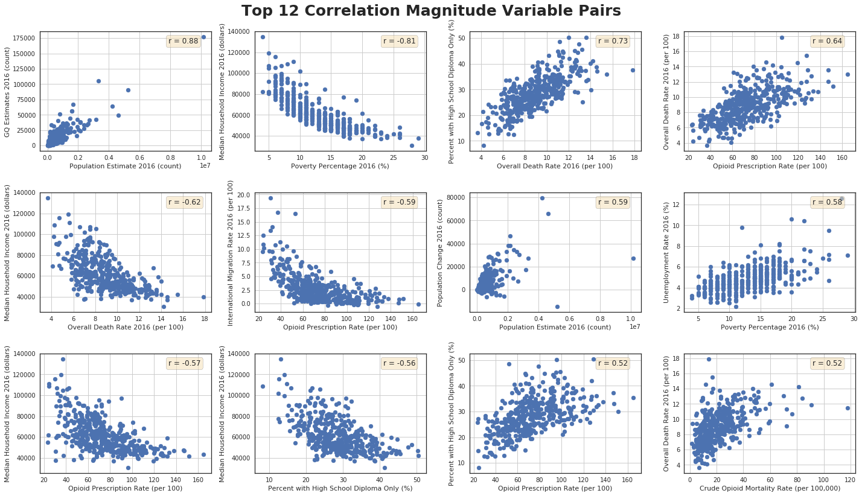
Notes:
From the above correlation heat map and the scatter plot, we can see the variables that have high correlation values. Also, it's important to note that not all the relationships are linear.

Slide 21
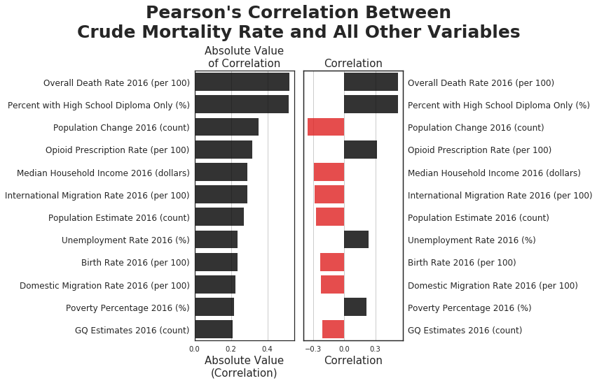

Slide 22
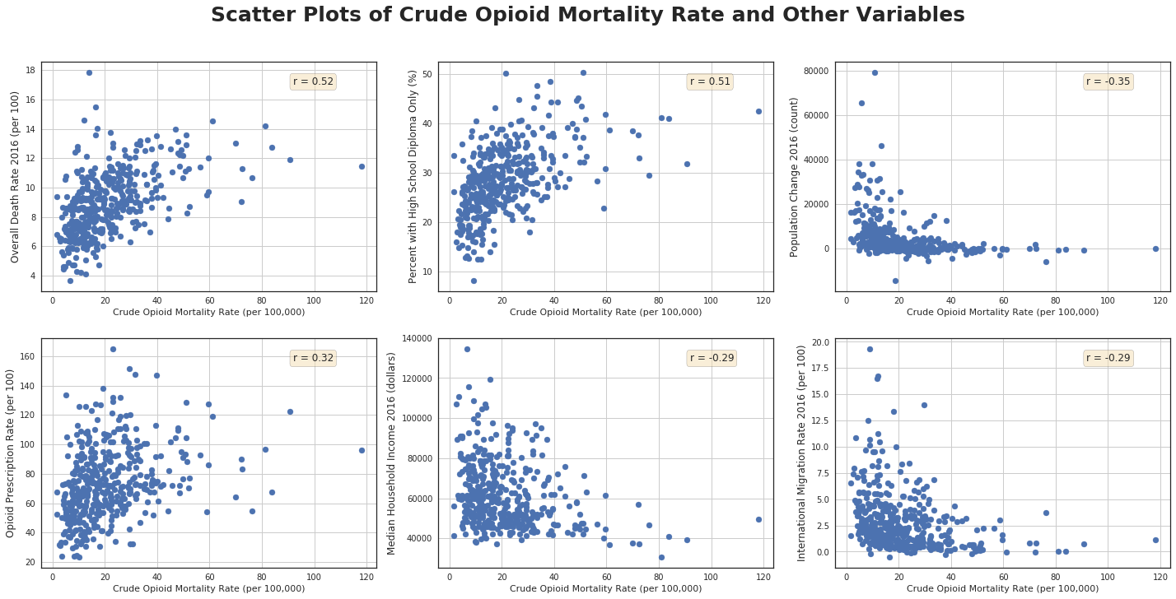

Slide 23
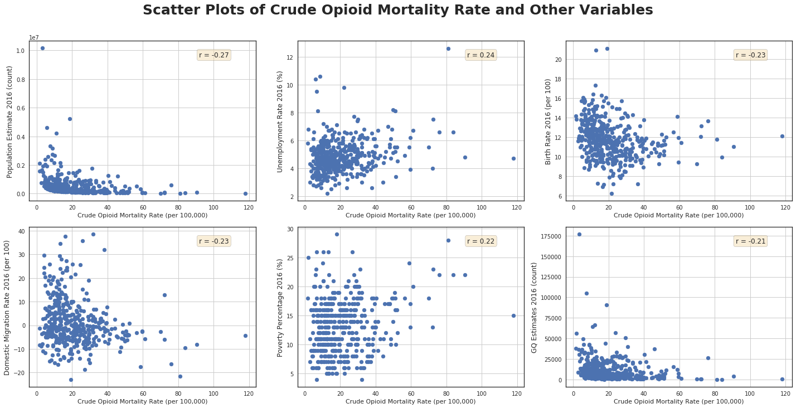

Slide 24
Hypothesis Test of Correlation By Permuting Samples
Could these correlation values be due to chance?
Or are the correlation values statistically significant?
To test this, let's run a hypothesis test of correlation by permuting samples for Crude Opioid Mortality Rate (per 100,000) and all other continuous variables

Slide 25
Hypothesis Test of Correlation By Permuting Samples - Procedure
Null hypothesis: Crude Opioid Mortality Rate (per 100,000) and one of the twelve continuous variable are completely uncorrelated. That is, ρ=0.
Alternative hypothesis: Crude Opioid Mortality Rate (per 100,000) and the other variables are correlated. That is, ρ≠0.
Simulate the data assuming null hypothesis is true by permuting the Crude Opioid Mortality Rate (per 100,000) column 10000 times and calculating the correlation with the other variables. This will create 10000 permuted replicates of sample Pearson correlation r.
Use sample Pearson correlation, rr, as a test statistic.
Compute p-value as fraction of permuted replicates that have r more extreme than the observed r.
Draw a conclusion based on significance level α=0.01.

Slide 26
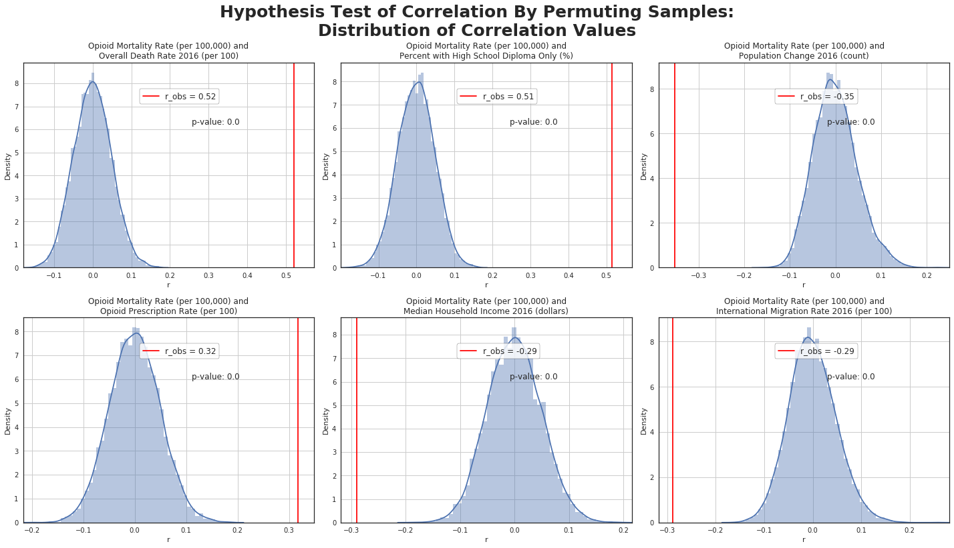

Slide 27
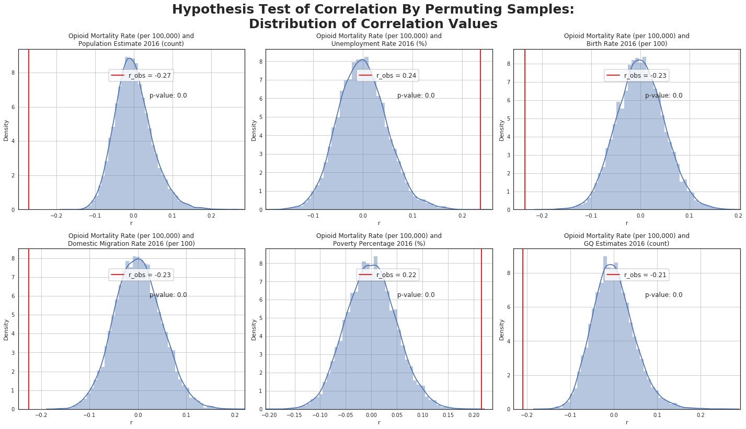

Slide 28
Linear Regression and Confidence Interval Using Pairs Bootstrap
Let's examine the following pairs of variables to see how much one variable influences the other linearly:
GQ Estimates 2016 (count) vs Population Estimate 2016 (count) (independent variable vs independent variable)
Percent with High School Diploma Only (%) vs Overall Death Rate 2016 (per 100) (independent variable vs independent variable)
Overall Death Rate 2016 (per 100) vs Opioid Prescription Rate (per 100) (independent variable vs independent variable)
Overall Death Rate 2016 (per 100) vs Crude Opioid Mortality Rate (per 100,000) (independent variable vs dependent variable)

Slide 29
Linear Regression and Confidence Interval Using Pairs Bootstrap - Procedure
Null hypothesis is that the slope between the pairs of variables is zero in a linear regression model.
Sample (x, y) pair of sample size n with replacement from the original sample of size n to obtain bootstrap sample of pairs of size n.
Fit a linear regression model from the bootstrap sample of pairs in step 1 and calculate the slope and intercept.
Repeat steps 1 and 2 B times. Here, I will use B=1000. This will create a bootstrap sampling distribution of the slopes and intercepts.
Construct 95% bootstrap confidence interval using the bootstrap sampling distribution of the slopes.
If the confidence interval from step 4 does not contain number 0, then reject the null hypothesis at α=0.05. Otherwise, do not reject the null hypothesis.

Slide 30
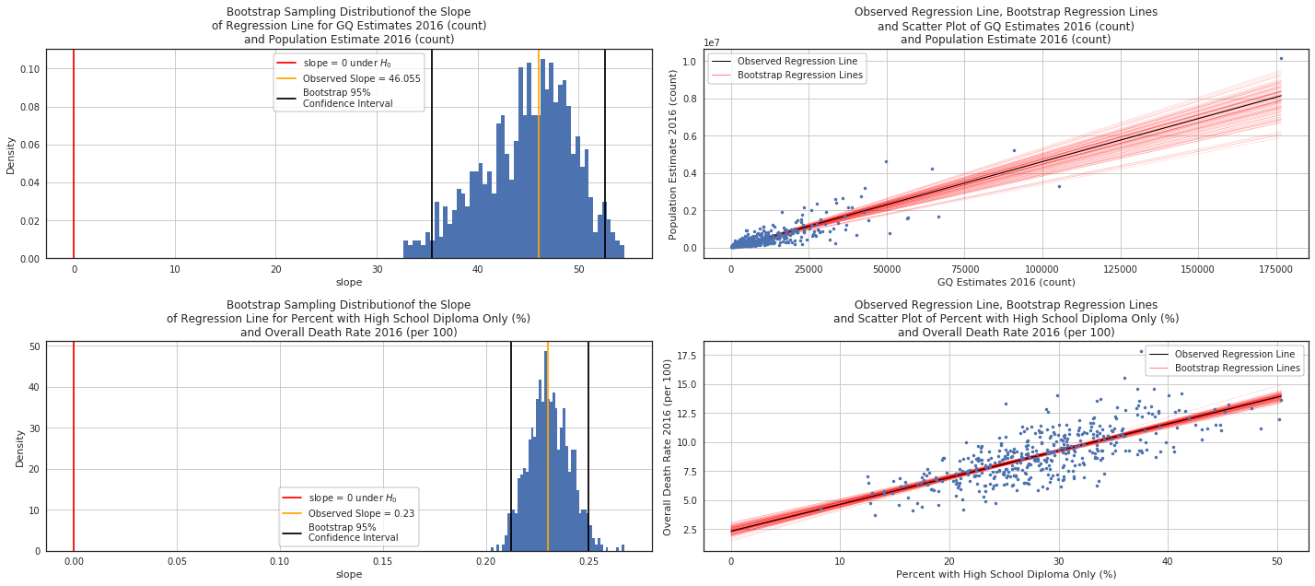
Linear Regression and Confidence Interval Using Pairs Bootstrap

Slide 31
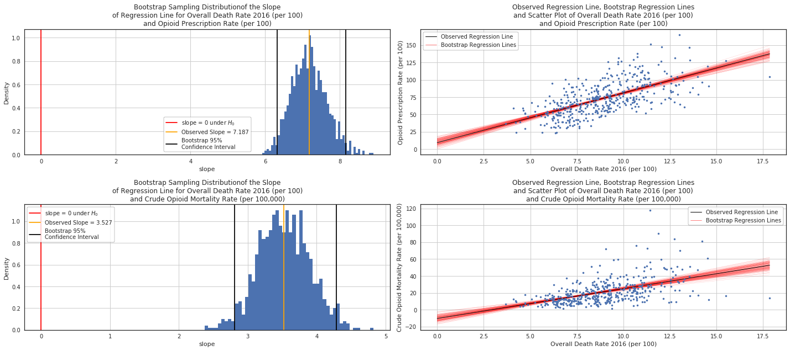
Linear Regression and Confidence Interval Using Pairs Bootstrap

Slide 32
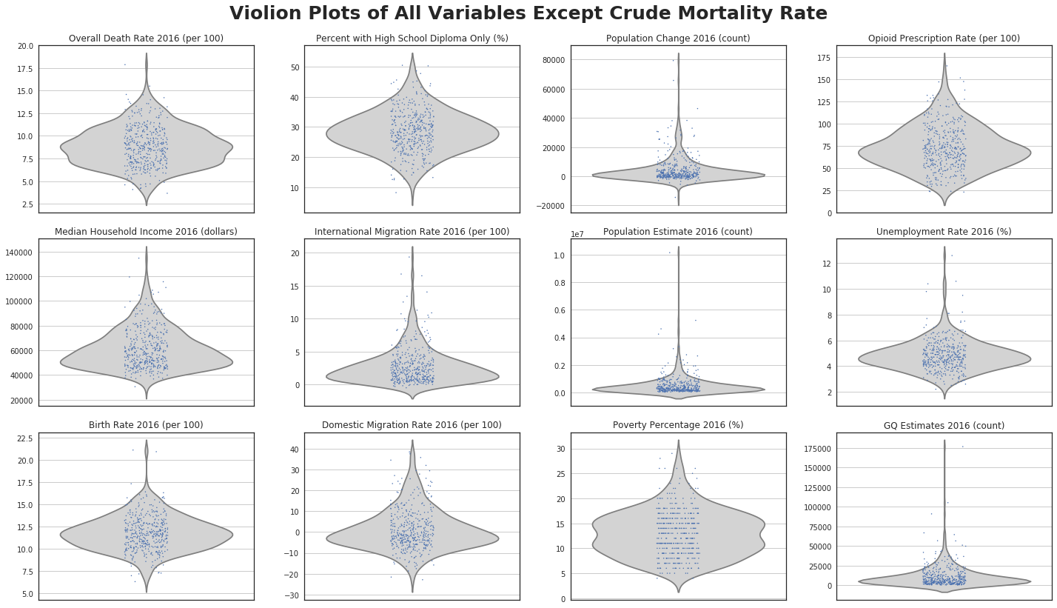

Slide 33
Conclusion From Exploratory Data Analysis
Counties with higher opioid addiction mortality rates caused by opioid addiction have
Higher overall mortality rate
Have more adults with high school diplomas only
Higher opioid prescription rates
Decrease in population size in 2016
Lower median household income
Possible reasons for these correlations
Population in these counties are older
These counties may not have good access to healthcare for the residents

Slide 34
Conclusion From Exploratory Data Analysis
Further research
Why do counties that have high percentage of the population with only high school diplomas have high opioid overdose mortality rate?
Possibly population in these counties are older
Possibly people in these counties may not have access to higher education for some reason

